Slide 1
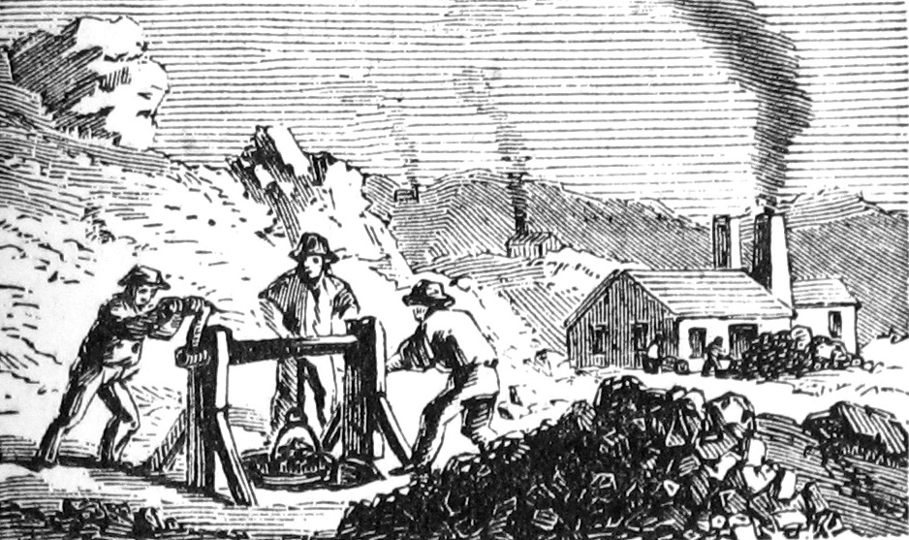
Vedanta Financial Valuation
Submitted To:
Prof. Girish Jain
Made By:
Abhishek Goyal (14DM009)
Aishwarya Jain (14DM016)
Akshay Majalikar (14DM024)
Avantika Mittal (14DM055)
Ayush Mittal (14DM057)
Karan Patel (14DM110)

Slide 2



About Industry
Metal and mining is expected to grow at 6% CAGR till 2025 from INR 1870 to 3550 Crs.
The Govt. allows 100% FDI under automatic route in the metals and mining industry.
By 2020, Metal and mining industry has the potential to contribute around USD150 billion to the GDP.

Slide 3

About Vedanta
Company was founded in now Mumbai in 1976 by Anil Agarwal.
2006 – Acquired Sterlite gold
2008 – Acquired Asarco, Copper mining Business
2011 – Acquisition of Cairn India
Vedanta recent buyout offer for Cairn India’s minority shareholder (Merger on track)

Slide 4


Assumptions & Reasoning
Growth rate: 5.5% (Expansion Phase)
Tax Rate: 30%
Rf: 7.75% - Based on 10 year GOI bond rate
Default Spread: 3.6% (Based on Moody’s Credit Rating Ba1)

Slide 5


Expected Growth
Al
Pb
Steel
Zn
Oil
Expected Sales Growth Rate:
10 year: 6%
5 Year: 6.5%
Company Growth Rate:
5.5%
Notes:
Lead: led by the Chinese expansion in automotive output and construction of mobile phone base stations

Slide 6
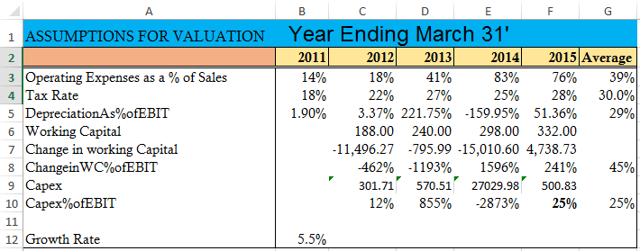
Cont..

Slide 7
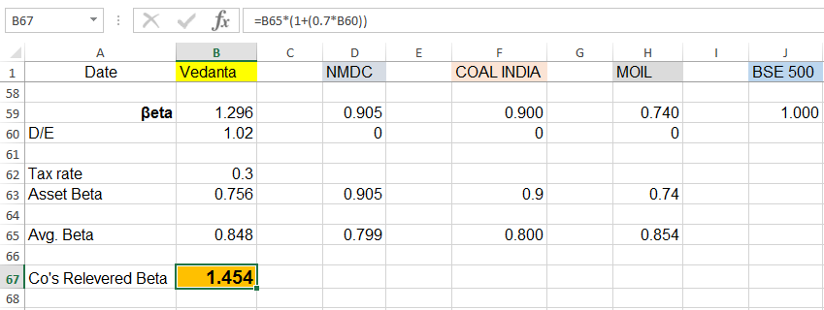
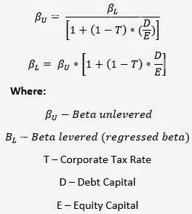
Beta Working (β)
Final Re-levered beta is calculated using average of unlevered beta of other 3 companies and tax rate of 30%.

Slide 8
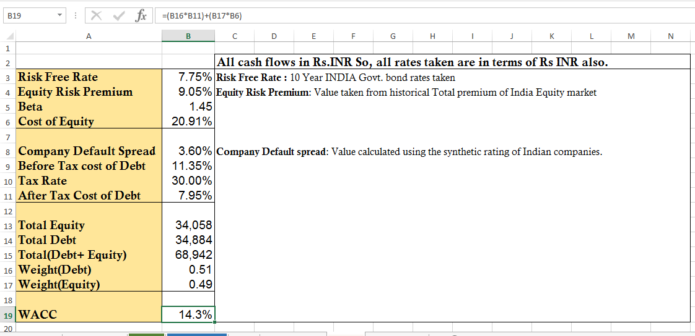
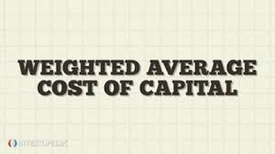

WACC CALCULATION

Slide 10

Price Earning Ratio
The Price-to-Earnings Ratio or P/E ratio is a ratio for valuing a company that measures its current share price relative to its per share earnings.
For Vedanta = 11.86 and its competitor Coal India has a P/E ratio of 18.7
Industrial average = 14.72
A low P/E can indicate either that a company may currently be undervalued or that the company is doing exceptionally well relative to its past trends.

Slide 11

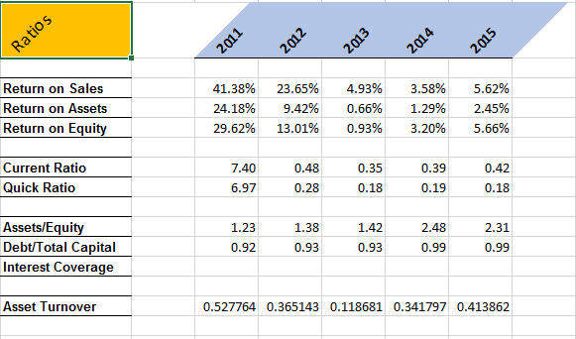

RATIOS

